Slide 1
Data passing between screens
Data application

Slide 2
One way – Send data
Global (Should avoid)
Source screen: Public static variable (Should avoid)
Destination screen: Constructor parameter

Slide 3

Global
Use Global class to store & retrieve data
Easy, fast
Not recommended! (Why?)
Notes:
Team work?
Multithread?
Structure of code?
Self contain?
But effective in small & real life!

Slide 4

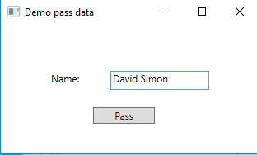
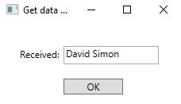
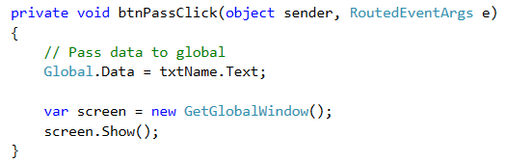
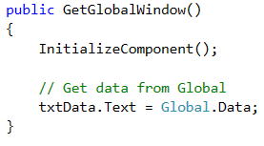
Global example

Slide 5
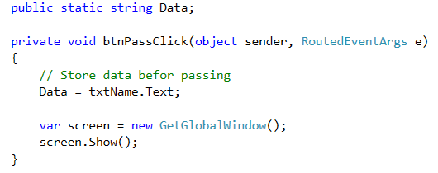
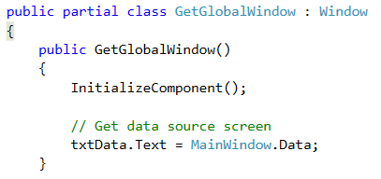
Public static
The source screen has public static variable

Slide 6
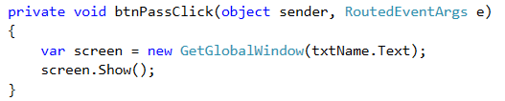
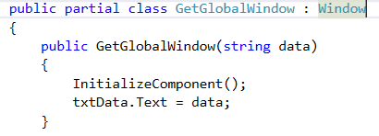
Constructor parameter

Slide 7
TwoWay – Get back data
Public static (again?)
Public property
Delegate & event

Slide 8
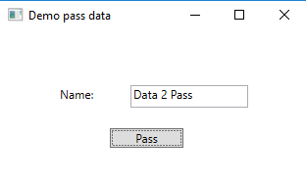
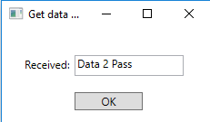
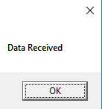
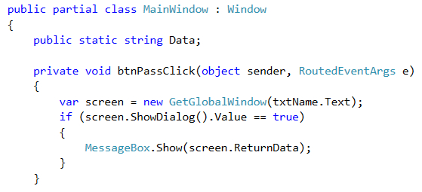
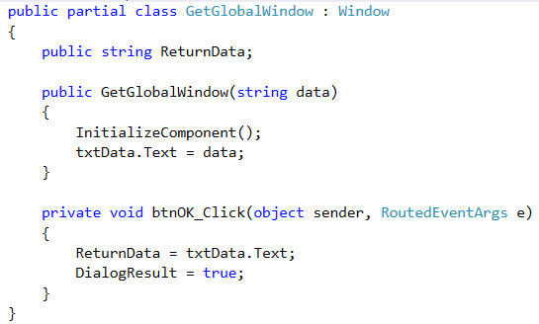
Public property

Slide 9
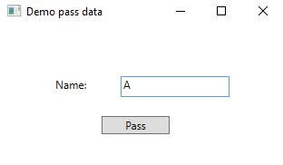
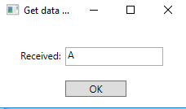
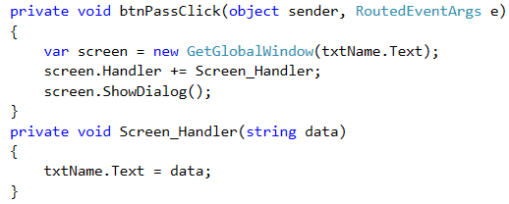
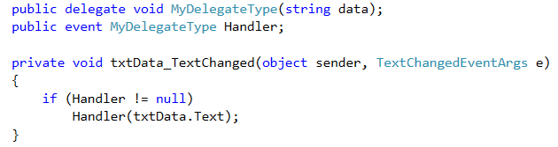
Delegate
Another demo
Demo

Slide 10
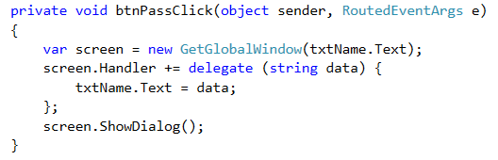
In short

Slide 11


Lambda expression
Siêu ngắn

